Slide 1
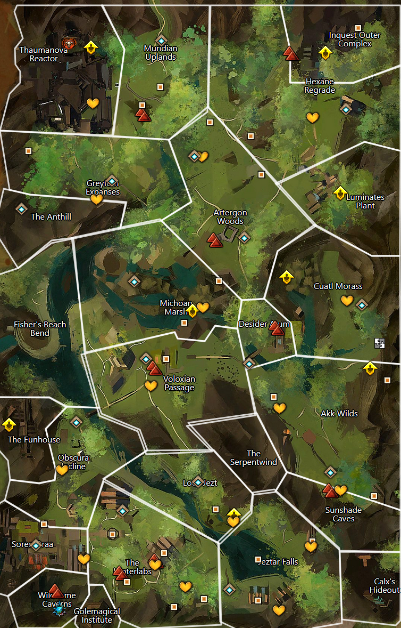

21
14
19
1-zojja-
18
1-welcome inventor
2-brain washing
3-interrupting research
4-not even the frogs are safe, note about fun house
5-open up it’s the….
6-plot to disrupt power to metrica
7-too busy with the rats
8-zojja drops in to send a message, pick up a crafting profesion.
9- She heard from a frog about a hidden entrance. Go ask for more details
10-frogs talk about how hunters in west report weird lights
11-found corpses of skritt and krait around a chaotic shard, look for local skritt den
12-holy broken core
13-assault the complex to see about notes on the power grid plan
14-find hologram of assault plan, return and head over to luminates plant
15-return refugees and continue on over to powergrid
16-keep powergid safe
17-turrets online, inquest complex to north threatens
18-thinning the herd
19-recover note mentioning thaumanuova - sabotage golem
20-stolen core taken north, theft covered up by toxins from failed experiment stay and help or move on
21-go find the stolen reactor core
20
13
15
16
17
12
9
11
10
8
7
6
5
4
1
2
3

Slide 2

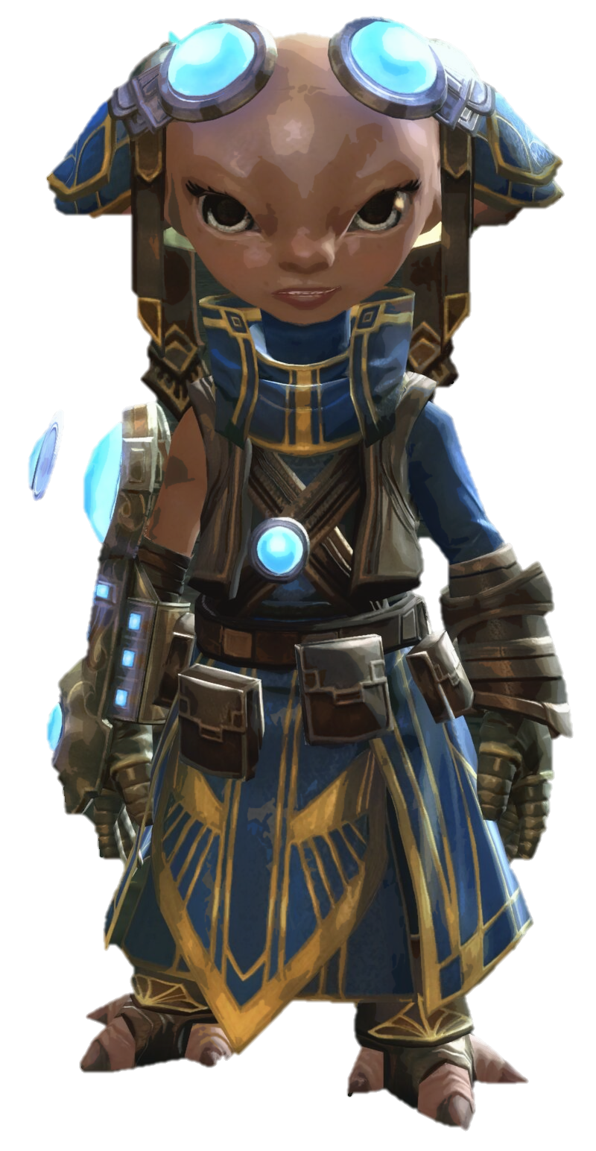

Text
text.
1
Zojja

Slide 3
text.
text.
Text
text.
3
2

Slide 4
text.
text.
Text
text.
5
4

Slide 5
text.
text.
Text
text.
7
6

Slide 6
text.
text.
Text
text.
9
8

Slide 7
text.
text.
Text
text.
11
10

Slide 8
text.
text.
Text
text.
13
12

Slide 9
text.
text.
Text
text.
15
14

Slide 10
text.
text.
Text
text.
17
16

Slide 11
text.
text.
Text
text.
19
18

Slide 12
text.
text.
Text
text.
21
20

Slide 13
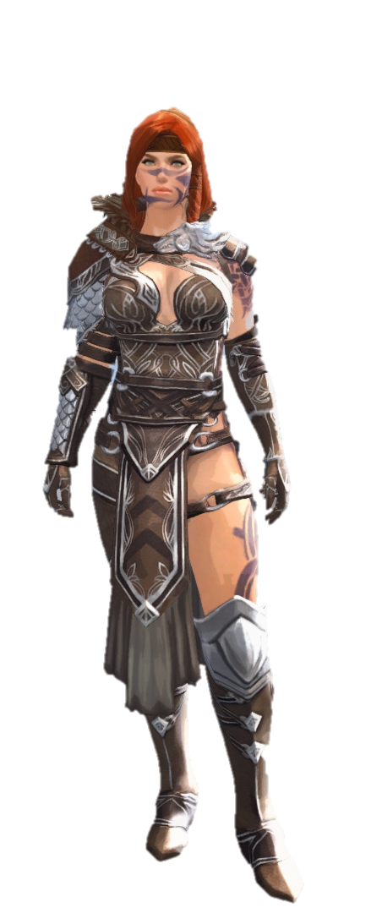

Slide 14
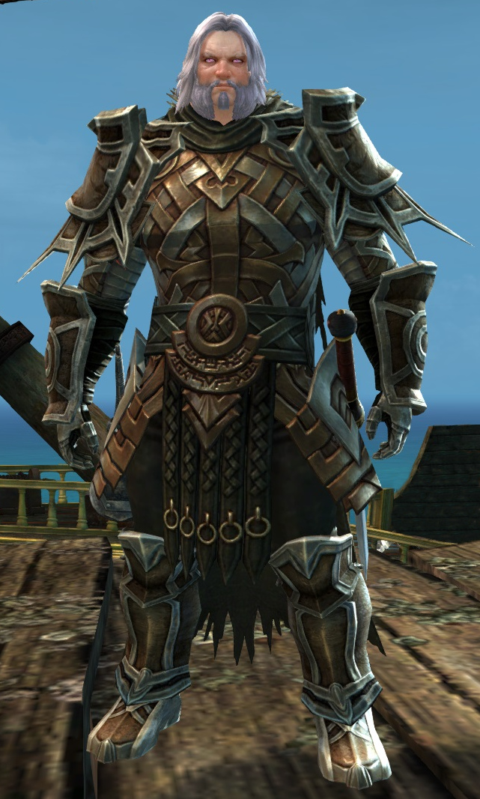
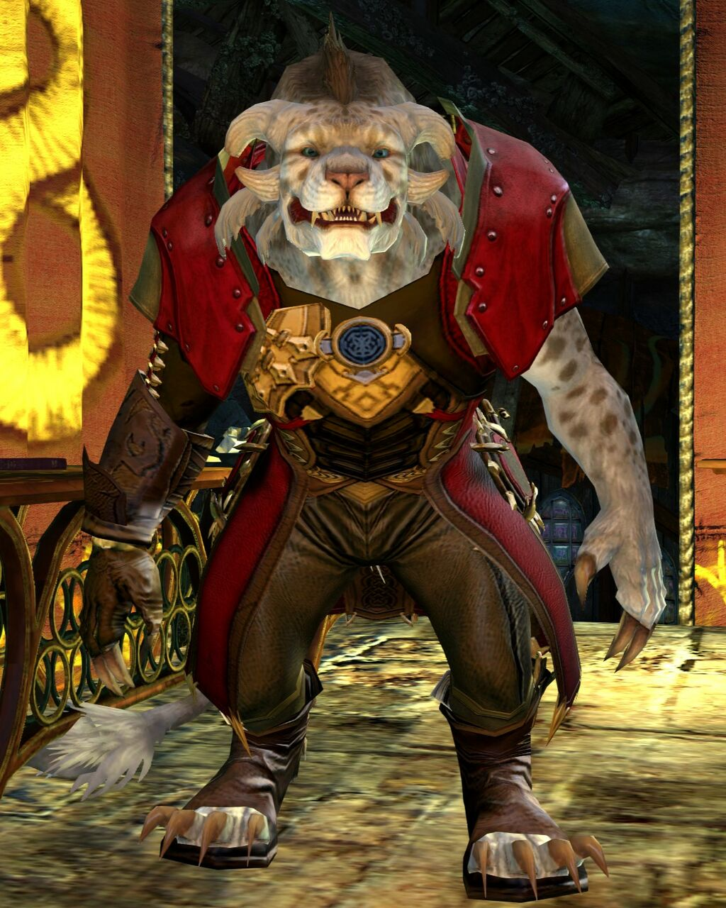
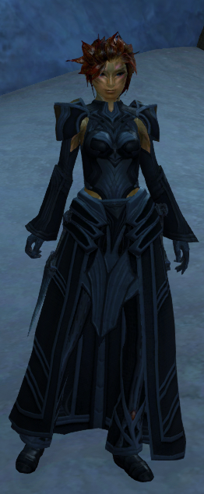

Slide 15
